Slide 1
UNO Game
By Nicolei Savage

Slide 2
Milestone 1:
Flowchart and Storyboard:
In Milestone 1 we created a flowchart and a storyboard. This allowed us to analyze the process that needs to take place for a functioning UNO game.

Slide 3
Milestone 2 & 3: ADT and UML Diagrams
For Milestone 2 & 3 we created an ADT and UML diagram. They displayed different classes within the Uno game and the data and methods kept inside the classes.

Slide 4
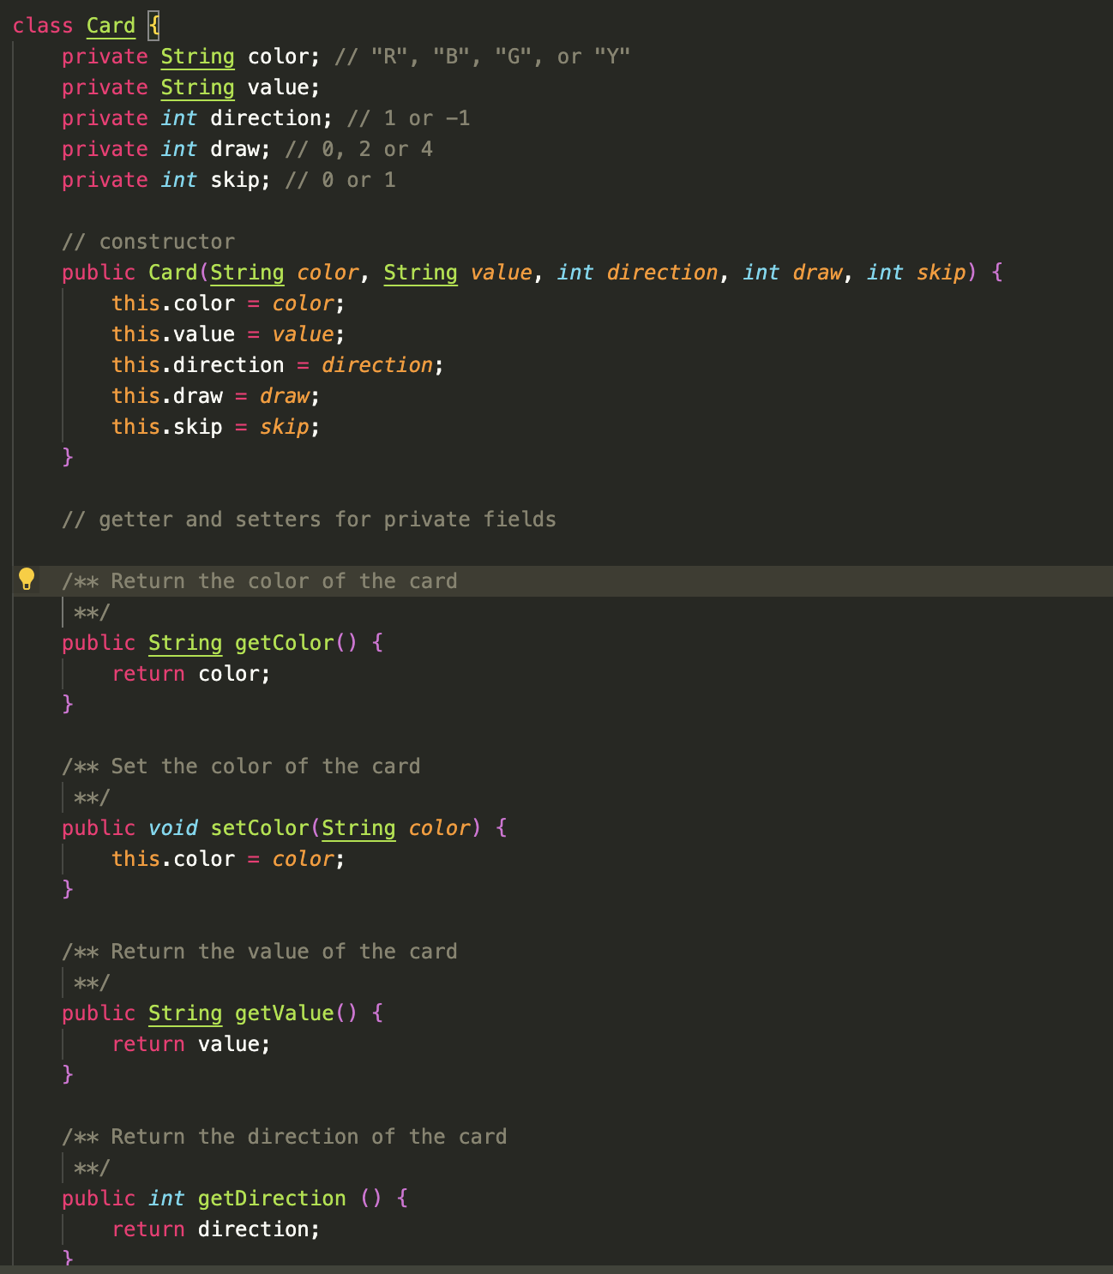
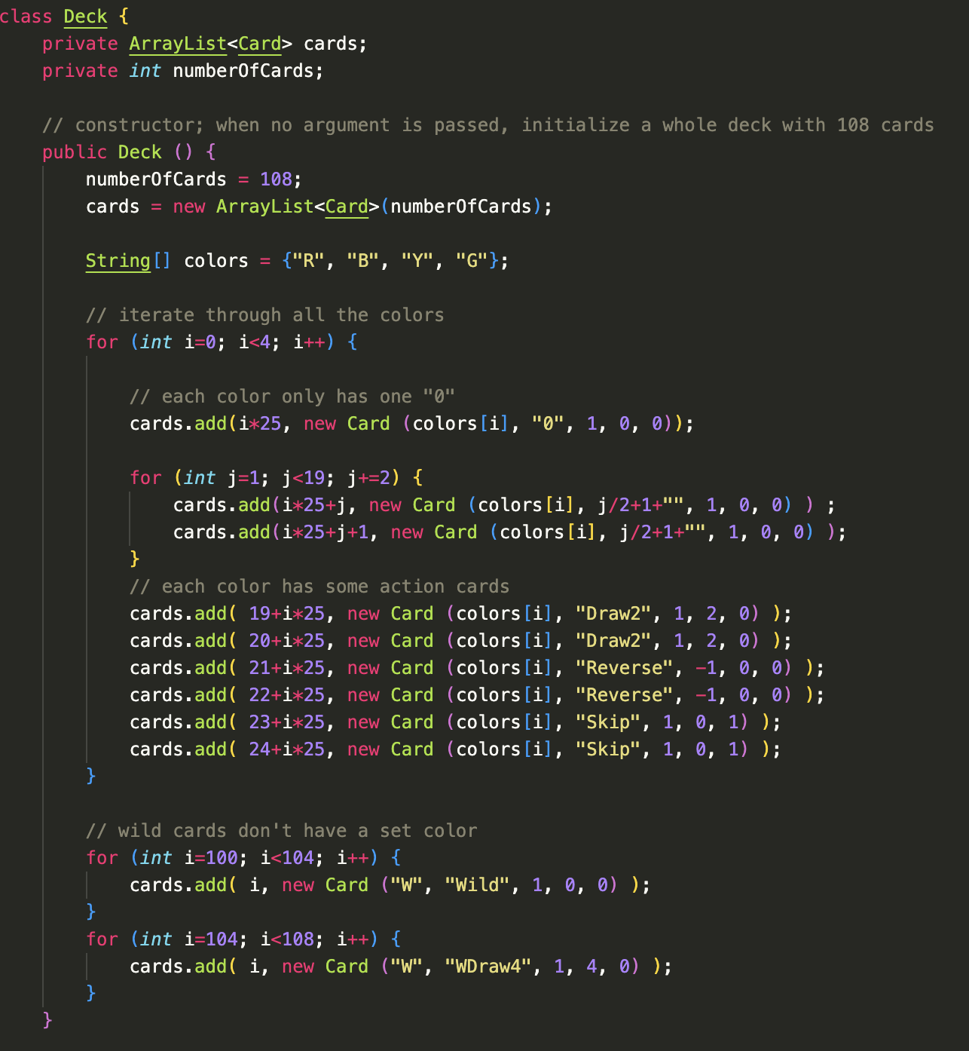
Milestone 4: A working game
Deck Class
Card Class

Slide 5
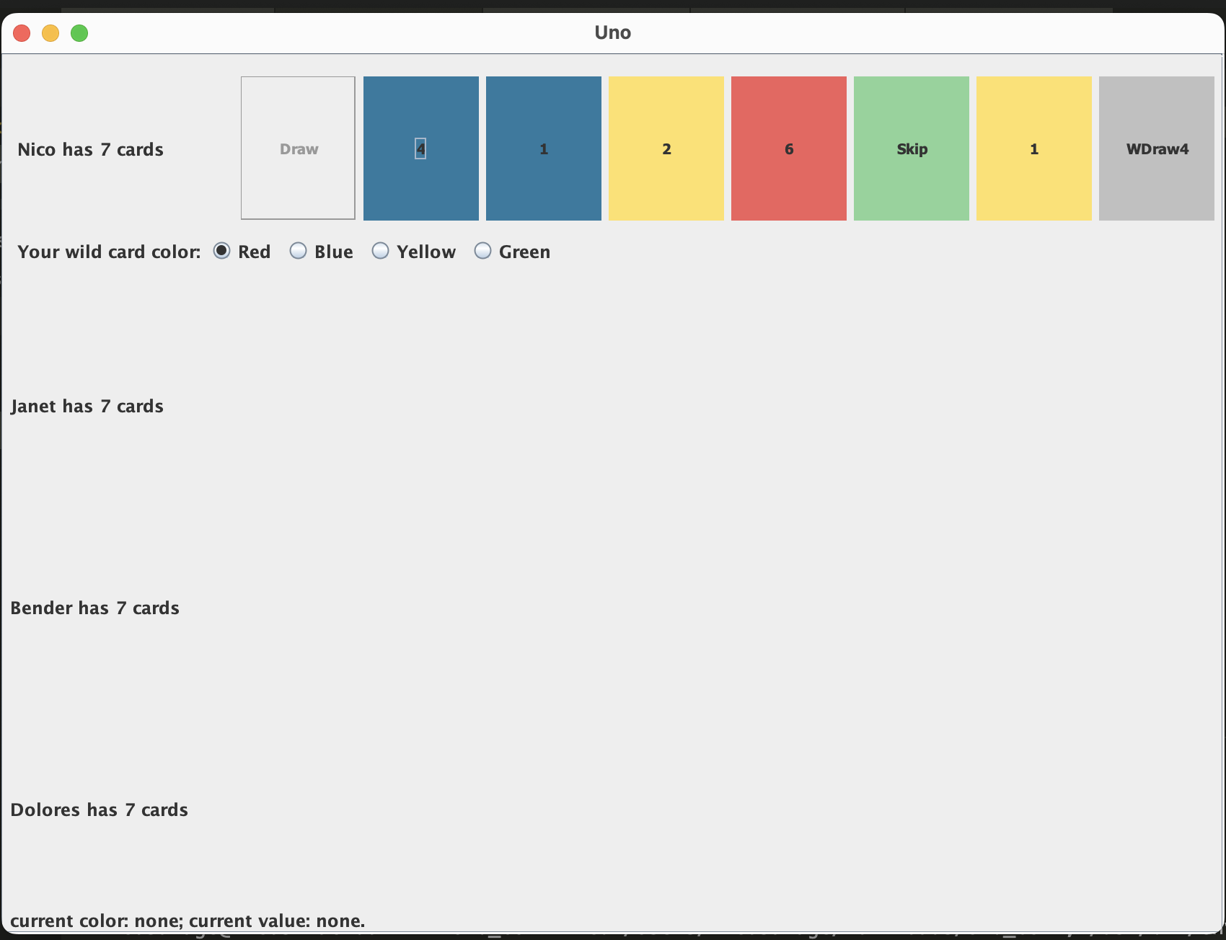
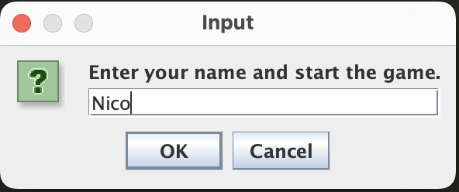
Milestone 5: GUI
Milestone 5 we created our game using a GUI

